Slide 1
Category review: Chips
June 2020
Retail Analytics
Brand note: If client logo is not required, use alternate title page layout right click slide thumbnail > Layout > Title

Slide 2
Notes:
To view Privacy video explaining how important data privacy is to Quantium, please click here: https://www.youtube.com/watch?v=Zq1QDAkoRzU
or here Q:\Company Reference\Brand & Design\Brand videos\Q Privacy.mp4
At Quantium, we believe that data is the behavioural footprint of humanity and that it has to be treated with the utmost care and responsibility.
Histories, attitudes, indeed lives are stored within it in ways that aren’t always apparent – and that’s what makes its potential so powerful.
To work with it responsibly, sensitively, we set ourselves the highest data privacy protection and governance standards.
We have spent 17 years perfecting privacy-by-design and secure-by-design principles. Central to this is not holding any personally identifiable information about people –
we neither receive it, and put the necessary protections in place to be unable to decipher it.
Every aspect of handling data is safeguarded: from its de-identification, to its encryption – data security is paramount and of the highest grade.
We pride ourselves on gaining the trust of iconic organisations around the world through years of securely working with their data,
and in turn the trust that builds with their stakeholders.

Slide 3
Executive summary
01
Task 1
From our task 1, we draw the following conclusions:
Sales are highest for (Budget, OLDER FAMILIES), (Mainstream, YOUNG SINGLES/COUPLES) and (Mainstream, RETIREES)
We found that (Mainstream, YOUNG SINGLES/COUPLES) and (Mainstream, RETIREES) are mainly due to the fact that there are more customers in these segments
(Mainstream, YOUNG SINGLES/COUPLES) are more likely to pay more per packet of chips than their premium and budget counterparts
They are also more likely to purchase 'Tyrrells' and '270g' pack sizes than the rest of the population
02
Task 2
Here you will include yourIt looks like the number of customers is significantly higher in all of the three months.

Slide 4
01
Category

Slide 5
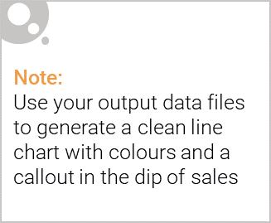
Sales are highest for (Budget, OLDER FAMILIES), (Mainstream, YOUNG SINGLES/COUPLES) and (Mainstream, RETIREES)
We found that (Mainstream, YOUNG SINGLES/COUPLES) and (Mainstream, RETIREES) are mainly due to the fact that there are more customers in these segments
(Mainstream, YOUNG SINGLES/COUPLES) are more likely to pay more per packet of chips than their premium and budget counterparts
They are also more likely to purchase 'Tyrrells' and '270g' pack sizes than the rest of the population

Slide 6

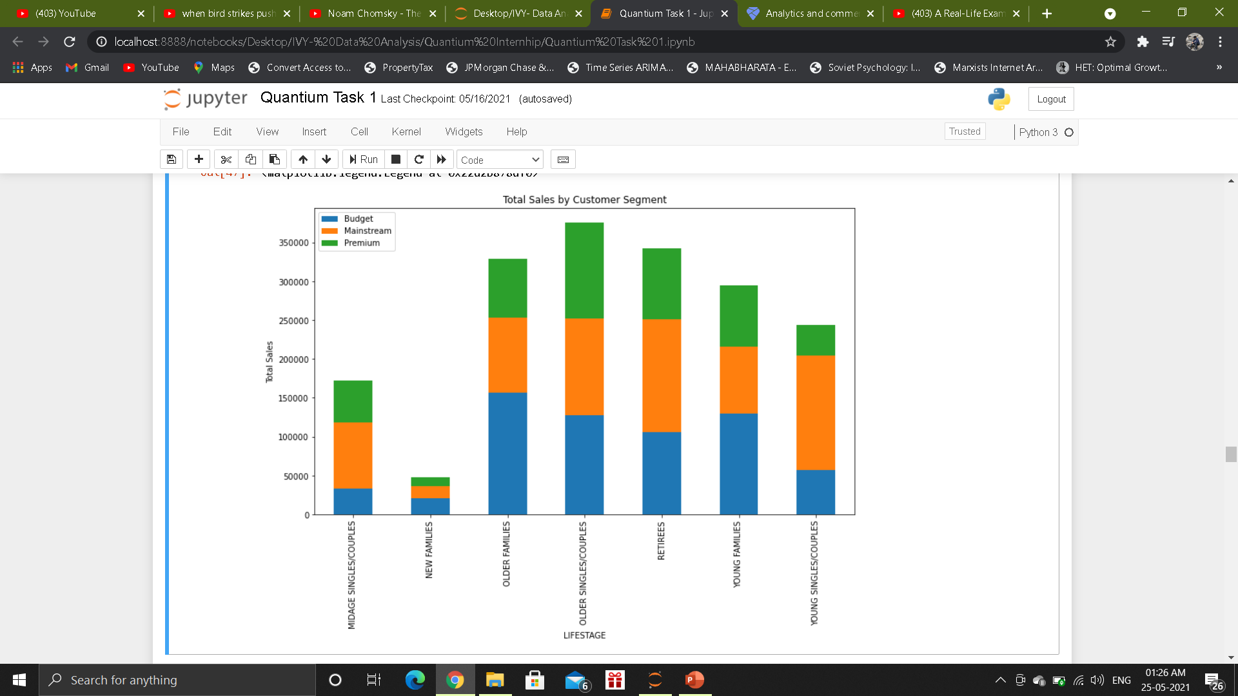
Top 3 sales come from budget older families, mainstream young singles/couples and mainstream retirees.

Slide 7
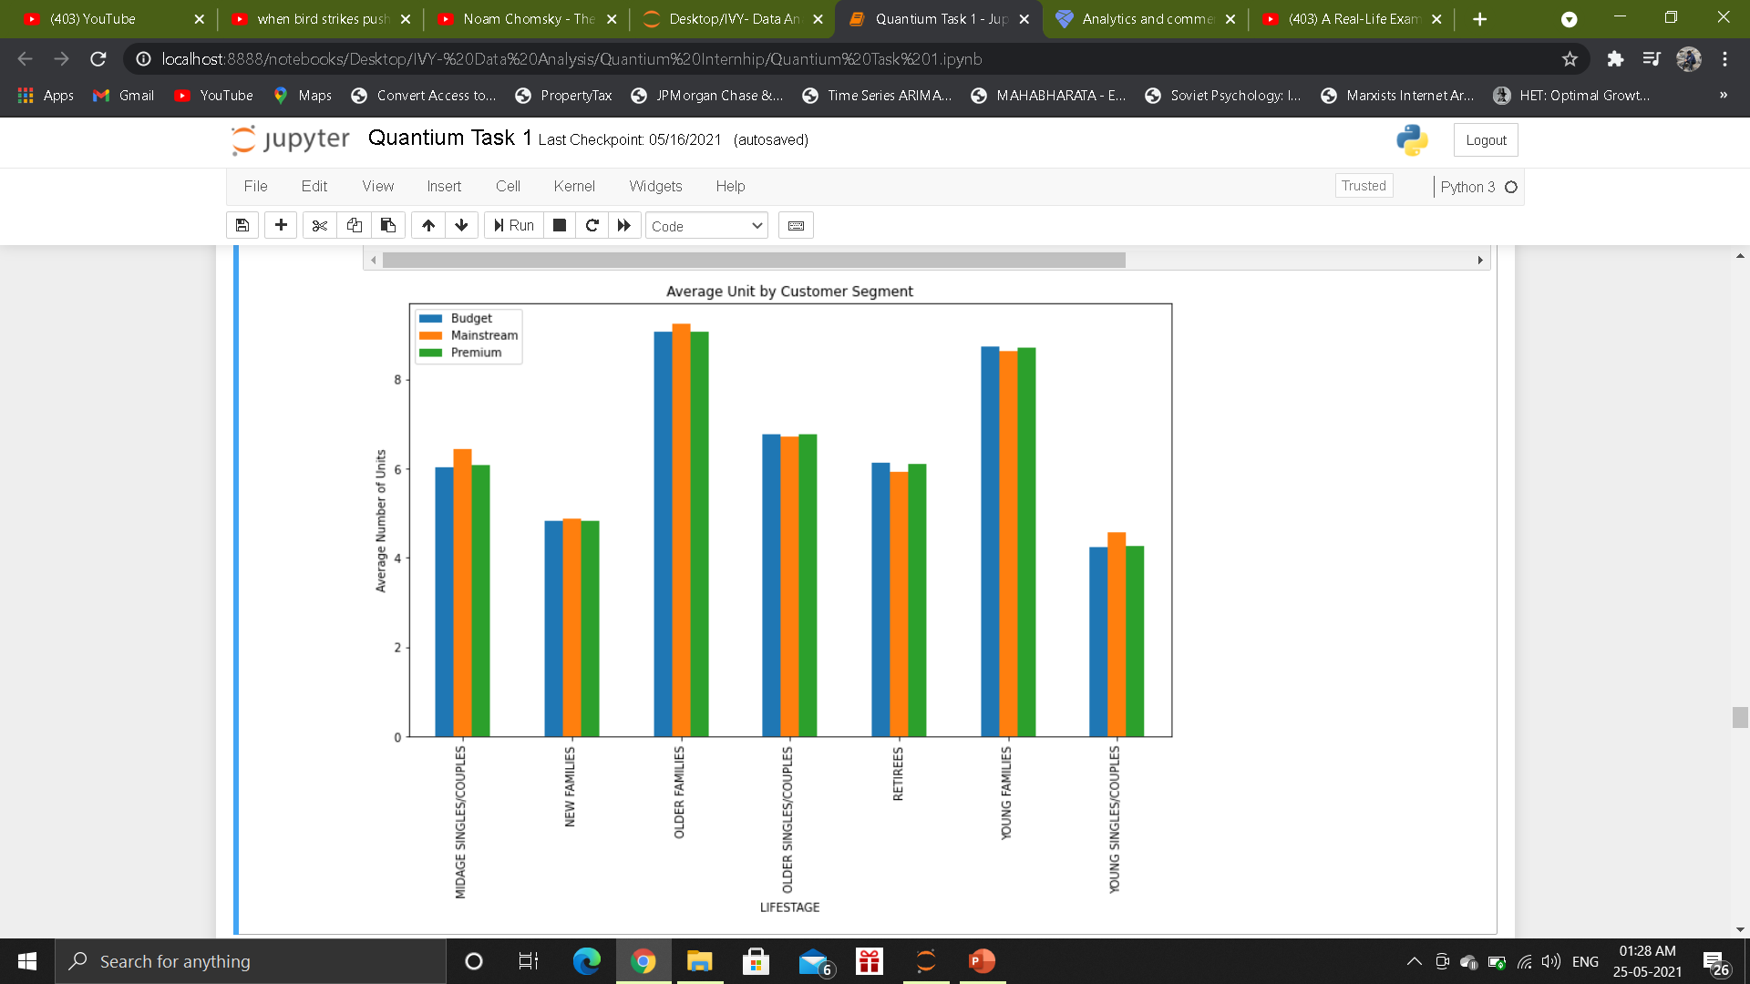
Older families and young families buy more chips per customer.

Slide 8
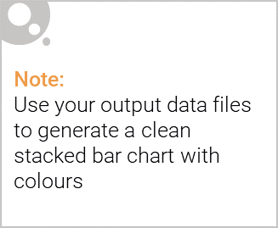
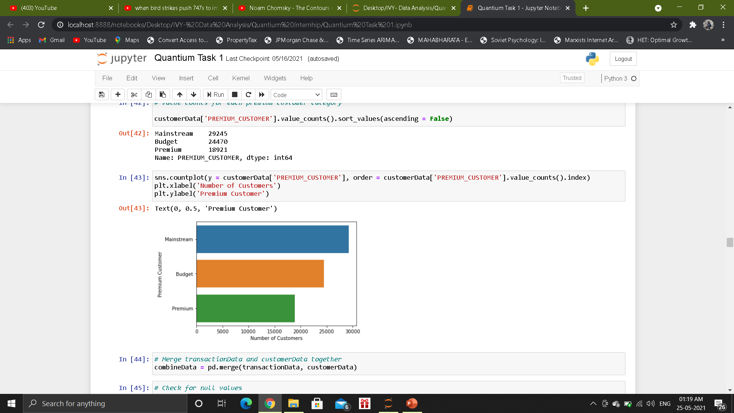
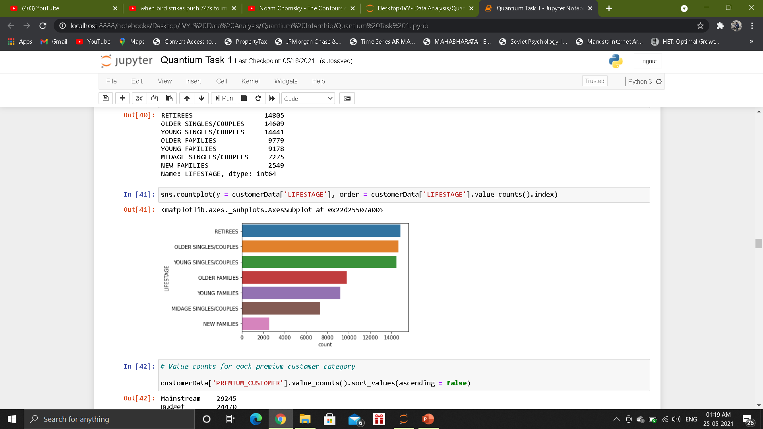
Editable (delete this)
Stretch: Try visualising the proportion of customers by affluence and life stage on this slide

Slide 9
02
Trial store performance

Slide 10
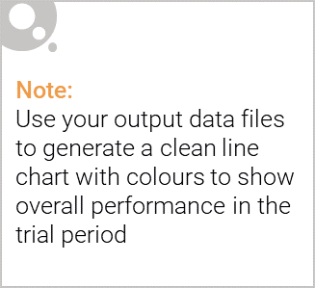
Total number of customers in the trial period for the trial store is significantly higher than the control store for two out of three months, which indicates a positive trial effect.
It looks like the number of customers is significantly higher in all of the three months. This seems to suggest that the trial had a significant impact on increasing the number of customers in trial store 86 but as we saw, sales were not significantly higher. We should check with the Category Manager if there were special deals in the trial store that may have resulted in lower prices, impacting the results.

Slide 11
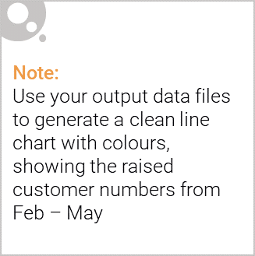
The results show that the trial in store 77 is significantly different to its control store in the trial period as the trial store performance lies outside the 5% to 95% confidence interval of the control store in two of the three trial months.
The results show that the trial in store 86 is not significantly different to its control store in the trial period. The trial store performance lies inside the 5% to 95% confidence interval of the control store in two of the three trial months.
The results show that the trial in store 88 is significantly different to its control store in the trial period. The trial store performance lies outside the 5% to 95% confidence interval of the control store in two of the three trial months.

Slide 12
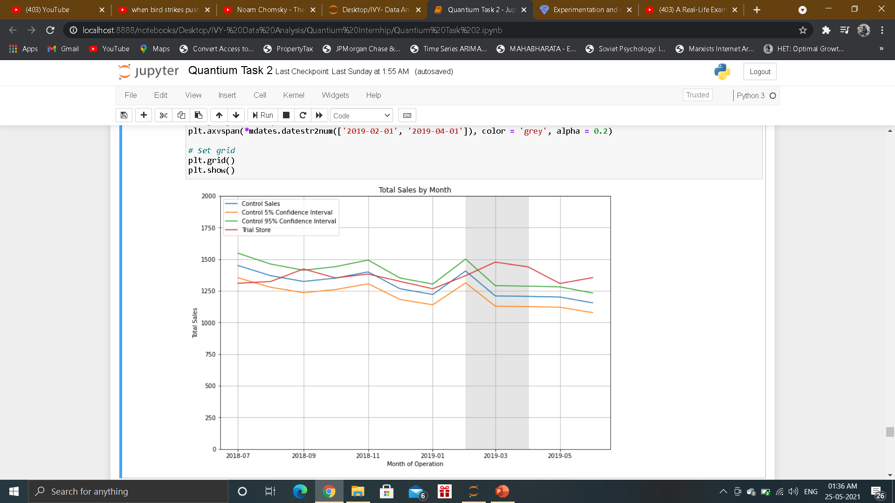
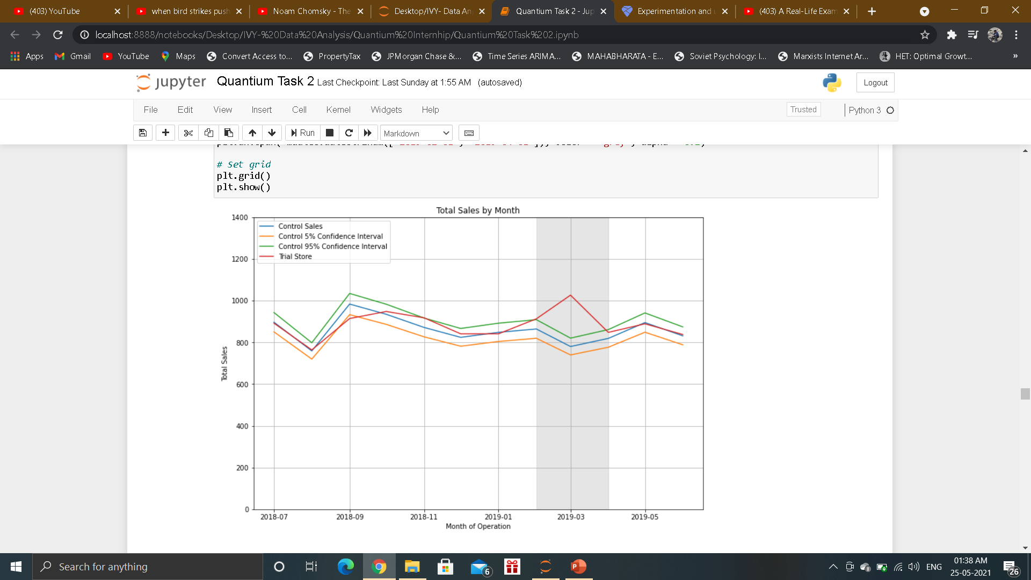
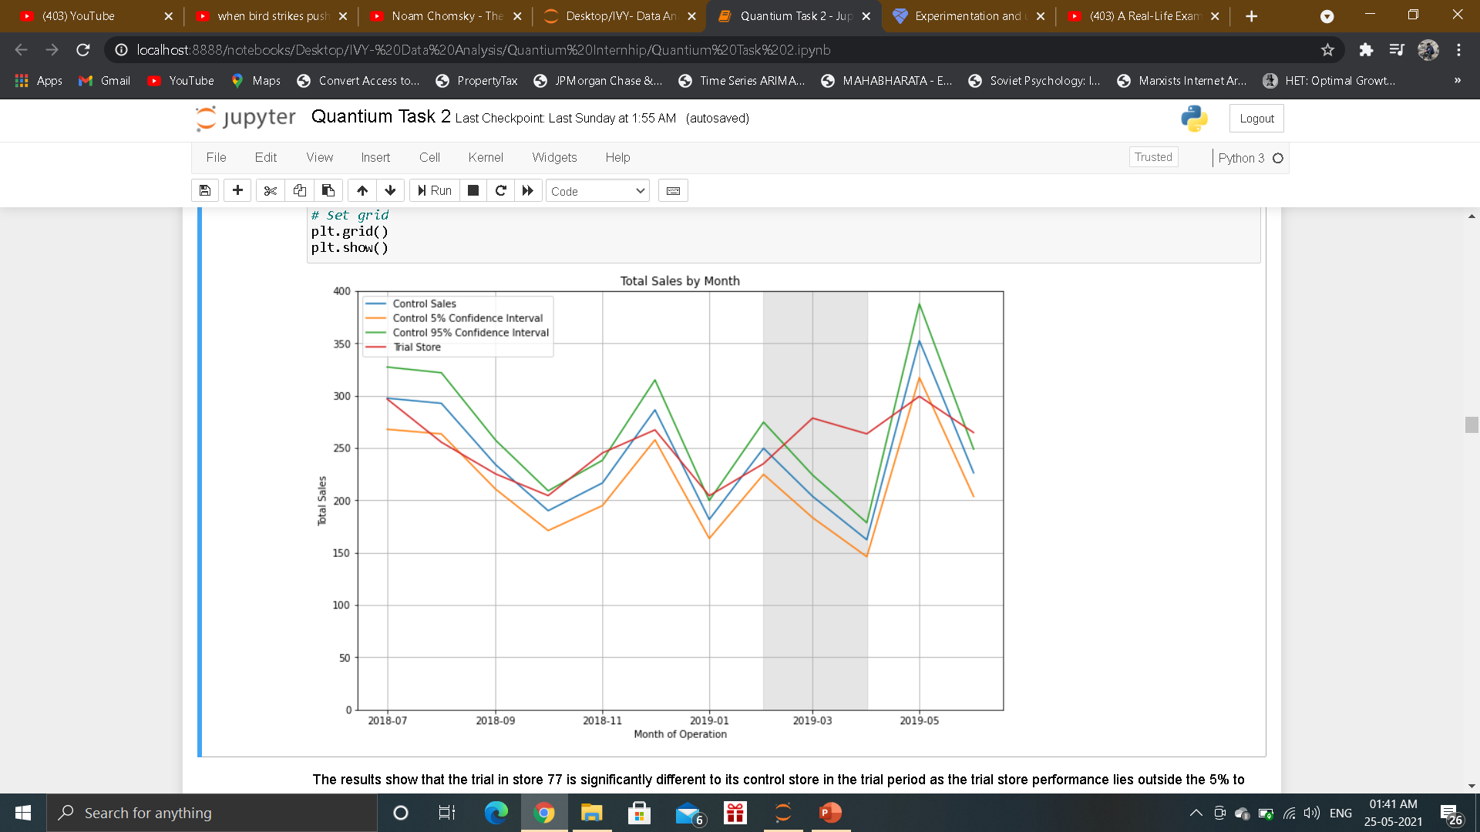
Assessment of trial for trial store 86
Assessment of trial for trial store 88
Assessment of trial for trial store 77

